Slide 1
Boomers Collaborative
A residential retirement cooperative and maker space
A project of Boomers Collaborative Foundation boomerscollaborative.org

Slide 2
Board Members & Steering Committee
Board Members
Carol Lilly
Karen Meschke
Matt Presley
John Vinson
Don Young
Steering Committee Members
Brian Donovan, The Cooperation Group
Matt Dietrichson, Student activist
Carol Lilly, Boomers Collaborative
Karen Meschke, Boomers Collaborative
Ryan Nill, La Reunion Cooperative Apartments
Matt Presley, Matt Presley Property Group / Boomers Collaborative
John Vinson, Attorney / Boomers Collaborative
Don Young, Pecan Street Media / Boomers Collaborative

Slide 3
The Need
To meet retirement or near retirement needs, many baby boomers seek…
Affordable Housing
Retirement Employment
Communal Support

Slide 4
The Drivers
Lack of affordable housing in urban settings
Targeting middle-income earners
Located near medical facilities
and transportation options
Lack of Economic Security / Opportunity
Many Baby Boomers cannot afford to retire
Jobs are harder and harder for them to find / keep
Many launch new businesses as
Encore Entrepreneurs
Most small businesses fail

Slide 5
More Drivers
The high rate of single baby boomers
50% of Baby Boomers are divorced
33% are single

Slide 6
Additional Public Health Rationale
Active and engaged seniors fare better in health and well-being.

Slide 7
About Encore Entrepreneurs in New York
Winnie Hu of The New York Times recently wrote (Sep 17, 2019) about this demographic in New York City:
Retire? These Graying ‘Encore Entrepreneurs’ Are Just Starting Up
“A growing number of New Yorkers are starting businesses in their 50s and 60s, even as their colleagues are easing into retirement…
“…The number of self-employed New Yorkers who were at least 50 rose to 209,972 in 2016, up 63.7 percent from 128,282 in 2000...
“…These older New York entrepreneurs are also part of a national trend, driven partly by the financial crisis a decade ago. Still, their numbers have grown even as the economy has rebounded…
“…Older entrepreneurs comprise an overlooked demographic group and require more resources and support services, said Jonathan Bowles, the executive director of the Center for an Urban Future.”

Slide 8
Existing Models (Across All Drivers) Offering Independent Solutions
Housing
Business
Live-Work Spaces
Co-Working Spaces
Maker Spaces
Small Business Incubators
Small Business Cooperatives
Business Networking Groups
Active Lifestyle Retirement Communities
Nonprofit Low-Income Affordable Retirement Housing
Co-Housing Efforts and Group Homes
Senior Housing Cooperatives

Slide 9
What else could we do?
Take a holistic approach with a new public-facing co-live / co-work / c0-making solution! Develop a mixed-income, mixed- use housing co-op, or co-op condo, that adheres to sharing-economy and cooperative organizing structures.

Slide 10
Our Solution — A Synthesis
Boomers Collaborative Foundation intends to change the nature of retirement by comprehensively addressing and producing savings across all drivers.
Locate on a transit line.
Take advantage of community-building layouts, hotel / motel design efficiencies, and cost-saving residential modular construction technology.
Share as much residential common space as possible to encourage neighbors to ‘bump into each other.’
Share commercial common space publicly through a co-maker / co-worker space, retail / gallery venue, and cafe / grill.

Slide 11
Prefer Housing Co-op over Condo
Boomers Collaborative believes a cooperative structure has the most to offer for building community, providing entrepreneurial supports, and eliminating isolation among seniors, as well potential to produce significant savings for members.
(Comparison available at National Cooperative Law Center website: http://nationalcooperativelawcenter.com/national-cooperative-law-center/comparison-of-housing-cooperatives-to-condominiums/.)

Slide 12
Legal Formation
To accomplish all our goals, our members have organized legally as an LLC and a 501(c)3 foundation.
Under our current bylaws, Boomers Collaborative (the LLC) operates as a cooperative and anticipates by time of closing to transition to a formal cooperative under state statute.
Boomers Collaborative Foundation (BCF) supports our nonprofit mission to help underwrite our cooperative initiatives and achieve charitable goals.

Slide 13
“Growth of Senior Cooperative Housing in the U.S. 1978-2011.” (SCF 2014)

Slide 14
Mission Statement
At Boomers Collaborative, Baby Boomers share resources and responsibilities to live, create, serve, and inspire.
Our mission is to create a new and sustainable model for senior co-living and neighborhood co-working that allows Baby Boomers to share resources and responsibilities to thrive and age in place in retirement.
Moreover, taking advantage of cooperative business structures, we strive to…
Empower fragile groups (especially Baby Boomers and other seniors) to have greater control over their socio-economic standing for individual health and well-being.
Create resilient beneficiaries through our direct socio-economic supports that nurture and help individuals thrive.

Slide 15
Vision Statement
Boomers Collaborative Foundation exists to reduce socio-economic stressors rampant in society today, doing so by…
Promoting the independence AND well-being of beneficiary Baby Boomers, their families, and other younger beneficiaries by sharing facilities, equipment, risk, and supplies.
Offering a new model for retirement living less dependent upon social and senior services that can be replicated all over the United States and the wider world.
Assuring that beneficiaries can co-live and co-work in a CO-OP tailored to local conditions and constituent needs through development that provides:

Slide 16
Vision Statement Cont’d
Sustainable mixed-use, mixed-income senior housing — outwardly focused for intergenerational and community engagement — within vibrant, urban-village settings.
Overall design that accommodates innovative LEED building practices; roof gardens; solar, wind, passive energy solutions, and the like.
A nonprofit small business / artisanal / maker incubator with office and studio space, as well as a storefront bistro with oversized kitchen, retail, gallery, and event space.
Educating and mentoring new and prospective beneficiaries in cooperative stewardship and other meaningful skills.

Slide 17
Physical Space Requirements / Description
Courtyard
Five-story Mixed-use Building
Six-story Tower
Notes:
Ground floor commercial lease space of approximately 32,000 ft² and four floors of residential units, with green roof, above.
Conventionally-built Tower building, with a footprint of 10,000 ft², for shared common-space uses with BCF and residential co-op uses as follow:
Ground level – Public dining / restaurant, retail venue, and event space.
2nd floor – Co-making / co-working space
3rd floor – Shared administrative offices, as well as private offices and conference rooms for lease.
4th and 5th floors – Flex lease space for either additional residential units (conventionally built at market-rates) or office lease space.
6th floor – short-term rental units, with solar roof.

Slide 18
Proposed Locations
North — Austin Energy, Justin Lane Property
South — Goodnight Ranch
Background: Austin Area Map of Major Roads from Best Map of

Slide 19
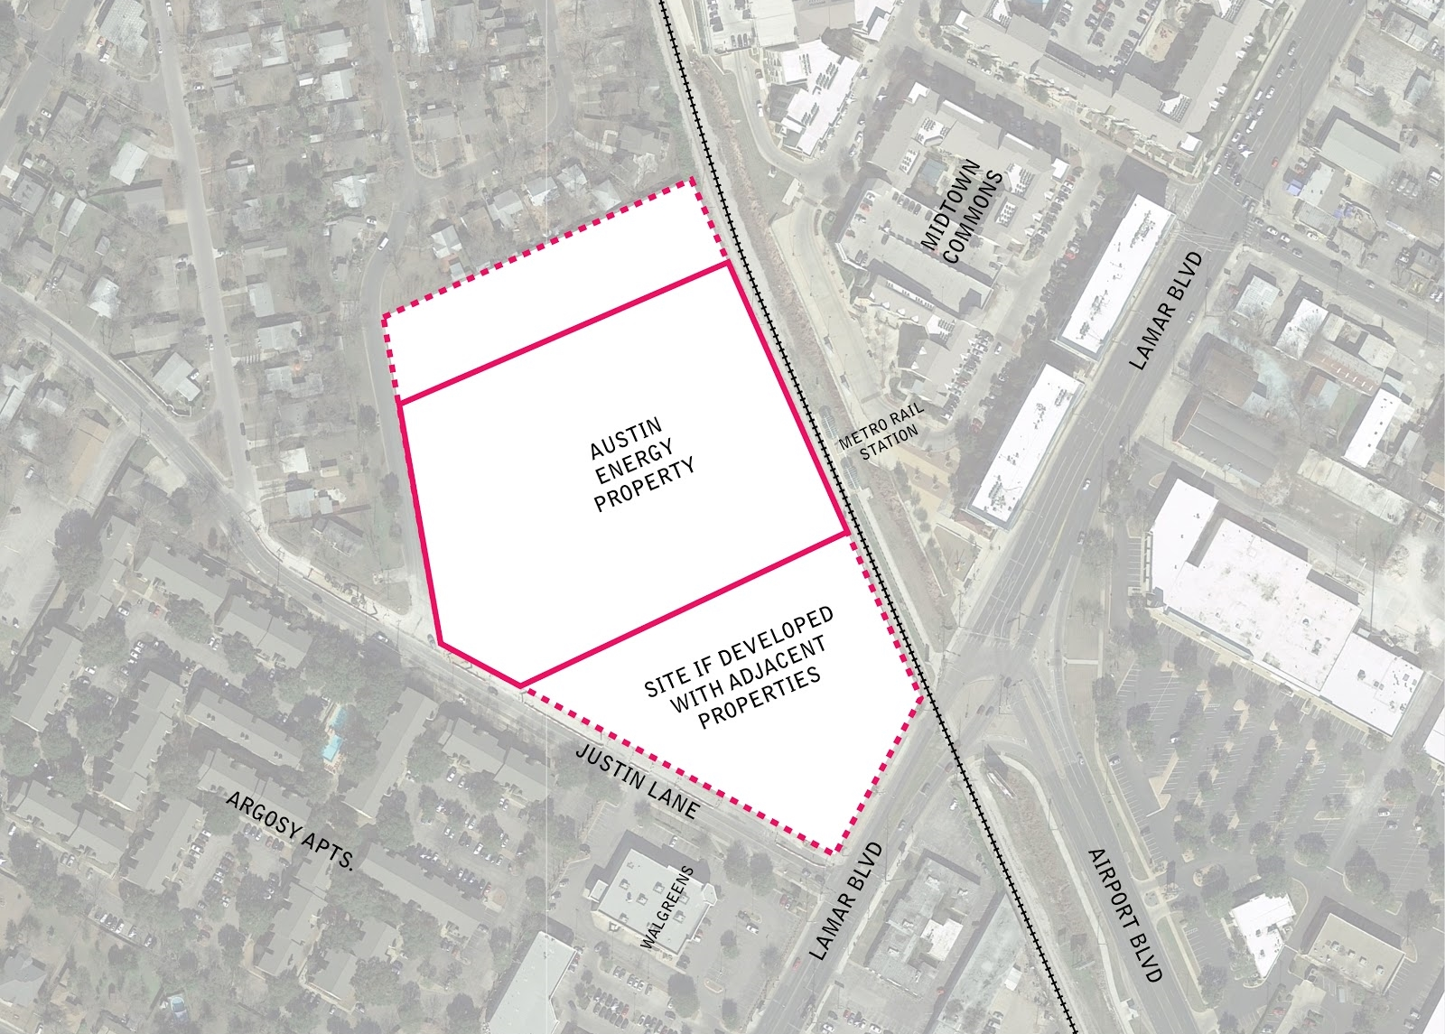
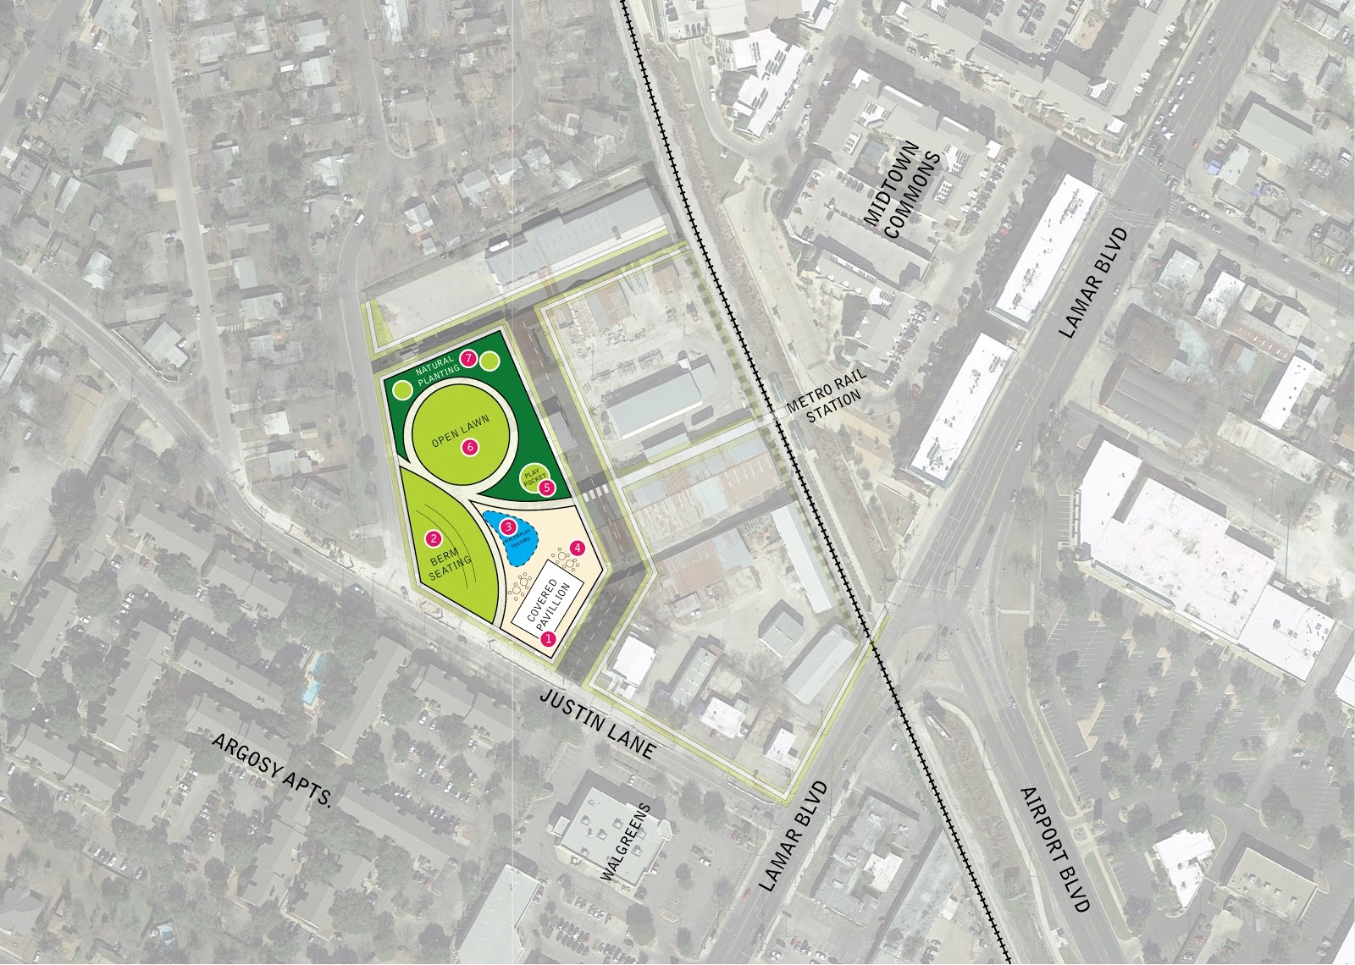
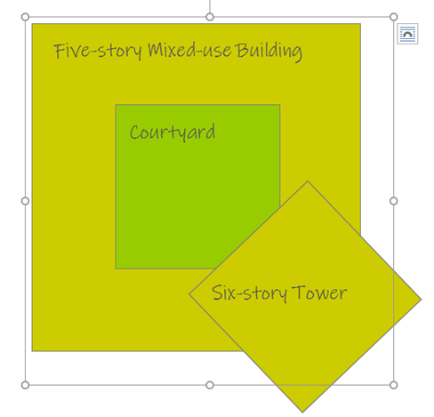
Austin Energy, Justin Lane Property
We are talking to parties to generate interest in including us in any new development for this site. It would be an ideal location for out flagship.
Renderings from City’s Lamar/Justin Lane Austin Energy Site: 6909 Ryan Drive Development Scenario Report (May 10, 2013) and Ryan Drive Working Group Report (April 2018)
Proposed site

Slide 20
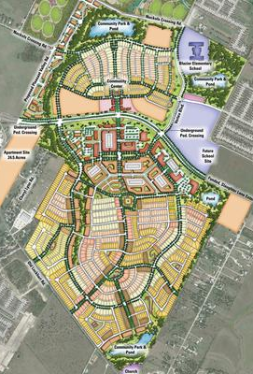
Goodnight Ranch
We have requested a meeting with principals and are awaiting their response.
Rendering from Google Maps.

Slide 21
Proposed Partners
City of Austin
Developers
Foundations
Other Co-ops
Resident-owners
Sponsor Businesses
Local Artists / Artisans
National Cooperative Bank
Notes:
We will be adding logos as alliances evolve.

Slide 22
Cost Allocations
City of Austin – Provides affordable ground lease to BCF and the Housing Co-op.
Developer – Provides interim financing to develop and build property improvements (a five-story mixed-use building for retail and light commercial on the ground floor, modular residential units above, and a green roof, with an integrated six-story tower building with retail and light commercial flex space.)
Housing Co-op & BCF – Purchase improvements from the developer.
National Cooperative Bank – Provides permanent financing.
NOTES: Housing Co-op owns and operates all housing square footage. BCF owns and operates all public-facing common space, splitting some costs with the Housing Co-op.

Slide 23
Results / Benefits
Co-op members enjoy
A sense of community and communal support.
Affordable, sustainable, and innovatively-designed LEED apartment homes with equity-holding advantages of home-ownership.
Excellent access to mass transit (bus & rail).
Small business and entrepreneurial supports.
Onsite commercial kitchen for commercial food / cafe / grill ventures, as well as communal or hospitality cooking, baking, catering, and event planning.
Peace of mind knowing their enhanced security presents fewer problems for their families.

Slide 24
Results / Benefits Cont’d
The wider community experiences
A healthier aging population, both mentally and physically, in less need of community support.
A social (and business) unit in a position to contribute and provide support to others.
Partners gain
A pro-active position for future projects.
An enhanced community image.

Slide 25
Other Important Information About Baby Boomers
For more information about this demographic to understand where Boomers Collaborative will intervene, please take time to read the following New York Times articles:
Retire? These Graying ‘Encore Entrepreneurs’ Are Just Starting Up: https://www.nytimes.com/2018/09/17/nyregion/nyc-startups-entrepreneurs-over-50.html
‘Too Little Too Late’: Bankruptcy Booms Among Older Americans https://www.nytimes.com/2018/08/05/business/bankruptcy-older-americans.html?action=click&module=RelatedCoverage&pgtype=Article&region=Footer

Slide 26
Q & A
Your questions and our answers.
Feel free to submit any additional questions / comments to us via email to boomerscollaborative@gmail.com.
Visit our website at boomerscollaborative.org and find us on Facebook @boomerscollaborative and Twitter @OhBoomer.

Slide 27
Works Cited
“Are Boomers Headed for Retirement Disaster?” ThinkAdvisor.com. Think Advisor. 31 Mar 2013. Web. 1 Nov 2014.
Bradford, Chris. “The Missing Middle.” AustinContrarian.com. Austin Contrarian. 3 Dec 2013. Blog. 19 Jul 2015
Carmody, Bill. “Why 96 Percent of Businesses Fail Within 10 Years.” Inc.com. Inc. Money. 27 Jan 2016. Web. 1 Feb 2016.
Dougherty, Connor, The New York Times. “Piece by Piece, a Factory-Made Answer for a Housing Squeeze.” 7 Jun2018. Web. 7 Jul 2018.
Clary, Greg and Athena Jones, CNN. “Baby Boomer Divorce Rate Doubles.” CNN.com. CNN Living. Web. 27 Jun 2012.
Hu, Winnie, The New York Times. “Retire? These Graying ‘Encore Entrepreneurs’ Are Just Starting Up.” NYTimes.com. 17 Sep 2o18. Web. 19 Sep 2018.
Hunter, Lori M. “Unmarried Baby Boomers Face Disadvantages as They Grow Older.” PRB.org. Population Reference Bureau, Article. Web Feb 2014.
Ingemunson, Eric. “Employer-Based Healthcare Hurts Older Workers.” VCStar.com. Ventura County Star, Blog. 21 Jun 2011. Web. 15 Apr 2013.
McWhinnie, Eric. “3 hard retirement truths facing Baby Boomers.” USAToday.com. USA Today. 21 Mar, 2015. Web. 19 Jul 2015.
MLS Area Map. “Major Austin Roads.” Google Search. Web. 21 Sep 2018
Schlueter, Nate. “Community First! Village: A Program of Mobile Loaves & Fishes.” MLF.org. Mobile Loaves & Fishes. 15 Oct 2014. Interview.
Senior Cooperative Foundation (SCF). “A Booming Trend.” SeniorCooperativeLiving.org. Senior Cooperative Housing. Web. 2014. 12 Feb 2014
Stangler, Dane. “The Coming Entrepreneurship Boom.” Ewing Marion Kauffman Foundation. Jun 2009. Web. 12 Feb 2014.
Wagner, Eric T. “Five Reasons 8 Out Of 10 Businesses Fail.” Forbes.com. Forbes / Entrepreneurs. 12 Sept. 2013. Web. 12 Feb 2014
Woodruff, Mandi. “There Are Way Too Many Single Baby Boomers.” BusinessInsider.com. Business Insider. 8 Feb 2013. Web. 12 Feb 2014.
Notes:
"

